Slide 1

School of Computing Science and Engineering
Course Code: BCS01T1003 Course Name: Programming for Problem Solving C
UNIT 2
CONSTRUCTS OF C
Introduction to C Programming Language
Program Name: B.Tech (CSE)

Slide 2
Recapitulations
Parts of a computer
Overview of
Operating Systems
Assemblers
Compilers
Interpreters
Flowcharts
Algorithms
Pseudo-code
Need for Programming Language

Slide 3
Objectives
What is C?
Features of C
Uses of C
Structure of a C Program
The Greeting Program

Slide 4
What is C?
C was developed by Dennis M. Ritchie in 1972 at the Bell Telephone Laboratories.
Dennis Ritchie is known as the founder of the c language.
In 1978, the publication of The C Programming Language by Kernighan and Ritchie revolutionized the computing world.
It was developed to overcome the problems of previous languages such as B, BCPL, etc.
Initially, C language was developed to be used in UNIX operating system.
In 1983 the American National Standards Institute established a committee to provide a modern, comprehensive definition of C. ANSI C was completed in 1988.

Slide 5
Features of C
Simple
C is a simple language in the sense that it provides a structured approach (to break the problem into parts), the rich set of library functions, data types, etc.
Mid-level programming language
Although, C is intended to do low-level programming. It is used to develop system applications such as kernel, driver, etc. It also supports the features of a high-level language. That is why it is known as mid-level language.
Fast and Efficient
C programming language as the been middle-level language provides programmers access to direct manipulation with the computer hardware but higher-level languages do not allow this.

Slide 6
Features of C
Portability
C language is lavishly portable as programs which are written in C language can run and compile on any system with either none or small changes.
Rich Library
C provides a lot of inbuilt functions that make the development fast.
Memory Management
It supports the feature of dynamic memory allocation.
Easy to Extend:
Programs written in C language can be extended means when a program is already written in it then some more features and operations can be added into it

Slide 7
Uses of C
Some examples of the use of C might be:
Operating Systems
Language Compilers
Assemblers
Text Editors
Print Spoolers
Network Drivers
Modern Programs
Data Bases
Language Interpreters
Utilities

Slide 8
Structure of a C Program

Slide 9
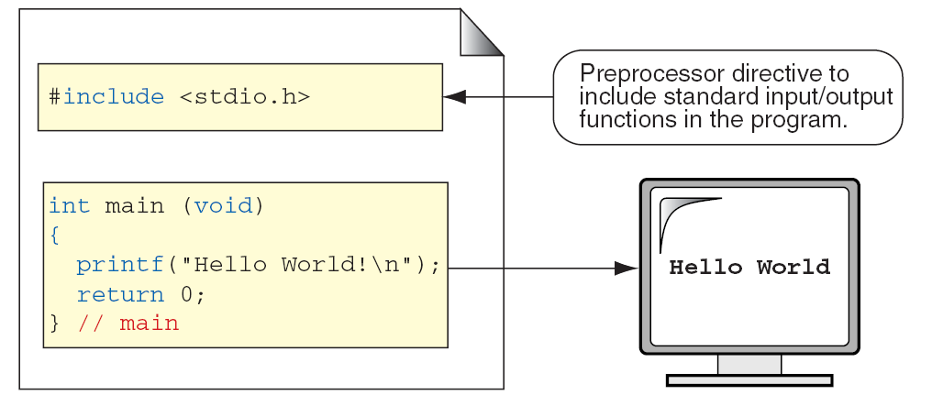
The Greeting Program

Slide 10
The Greeting Program

Slide 11
Comments in C
// This is a single line comment

